Slide 1


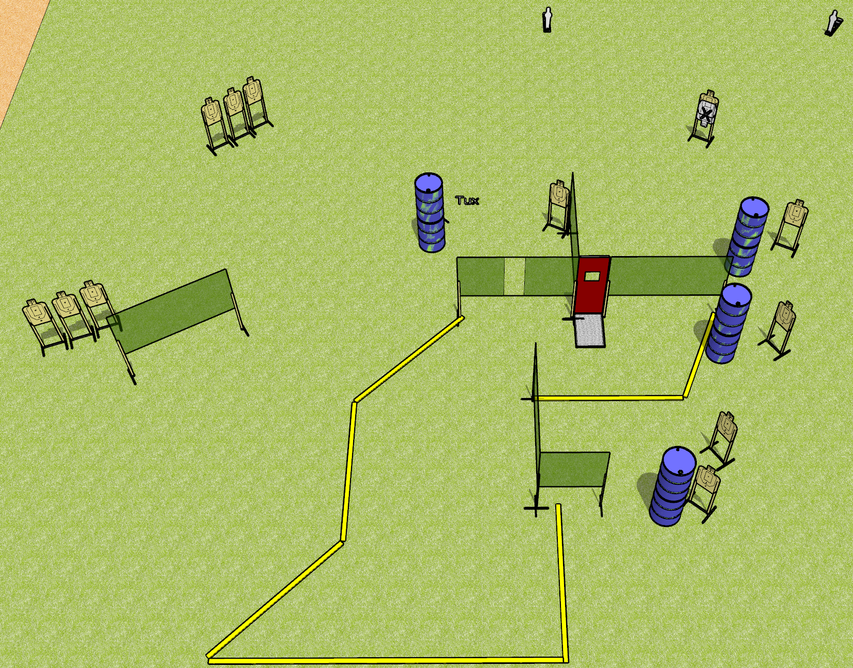
 | Dothan Gun Club – USPSA Match Not This Again Course Designer : Drew Coleman
Round Count 28 rounds 13 USPSA 2 mini poppers
Equipment List 10 wall feet 1 tux 13 targets (12 + 1 NS)

Slide 2
Not This Again
Written Stage Briefing
Not This Again is a 28 round, 140 point, Comstock course of fire. There are 13 USPSA targets and 2 steel. The best 2 hits on cardboard will score and steel must fall to score. The start signal is audible.
Handgun start position is anywhere inside the shooting area, wrists below belt. Handgun is loaded and holstered.
PCC start position is anywhere inside the shooting area, stock on belt. Loaded carbine is held with both hands.
On the audible start signal, engage targets as they become available from within the shooting area.

